Slide 1
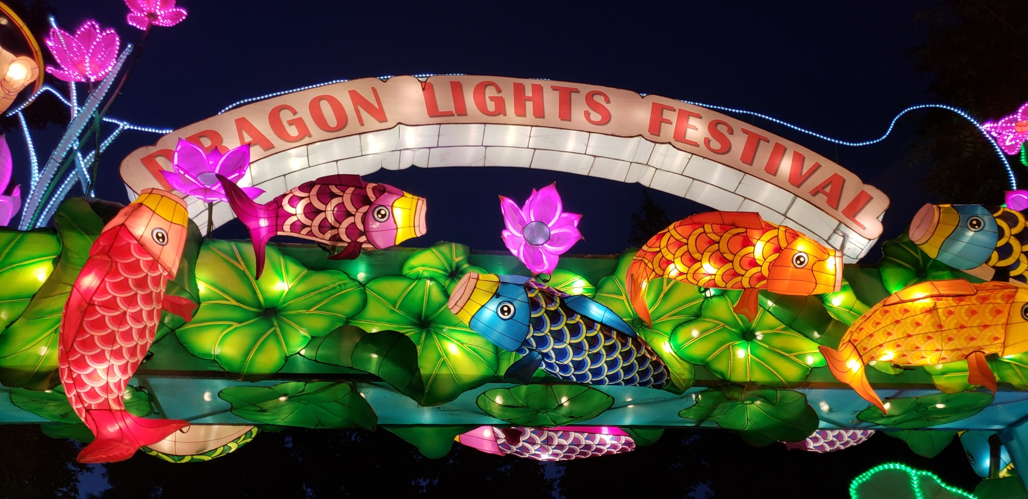
Dragon Lights Reno 2018

Slide 2
Dragon Lights Reno 2018
Agreement between Washoe County, Tianyu Arts & Culture, and the May Arboretum Society was accepted by the Board of County Commissioners on 2/27/18
  Tianyu was responsible for most of the logistic details (marketing, ticket sales, parking, daily clean-up/etc.)
  The agreement called for a 90/10 split of gross tickets sales
  Tianyu arrived in Reno in May 2018 when the planning and preparation began

Slide 3
Dragon Lights Reno 2018
Festival set-up began June 10th
VIP/Media Night June 28th
County/MAS night June 29th
Opened to the public June 30th
37 consecutive days of festival
One weather related closure
Closed on Sunday August 6th
Festival breakdown was complete August 16th

Slide 4
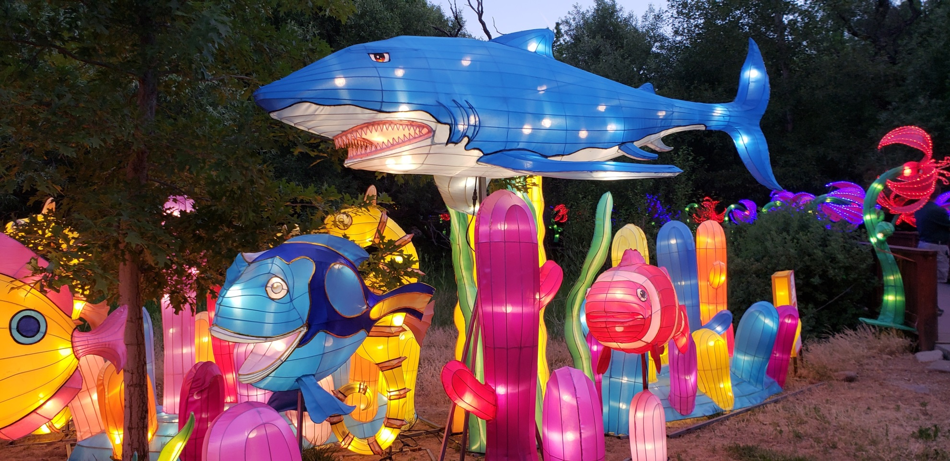
Dragon Lights Reno 2018

Slide 5
Dragon Lights Reno 2018
Statistics of festival
  Total attendance 62,564 people -does not include children 5 and under
  Average # of people/day 1691
  Highest attendance was 3910 on August 5th
  Lowest attendance was 550 on July 4th

Slide 6
Dragon Lights Reno 2018

Slide 7
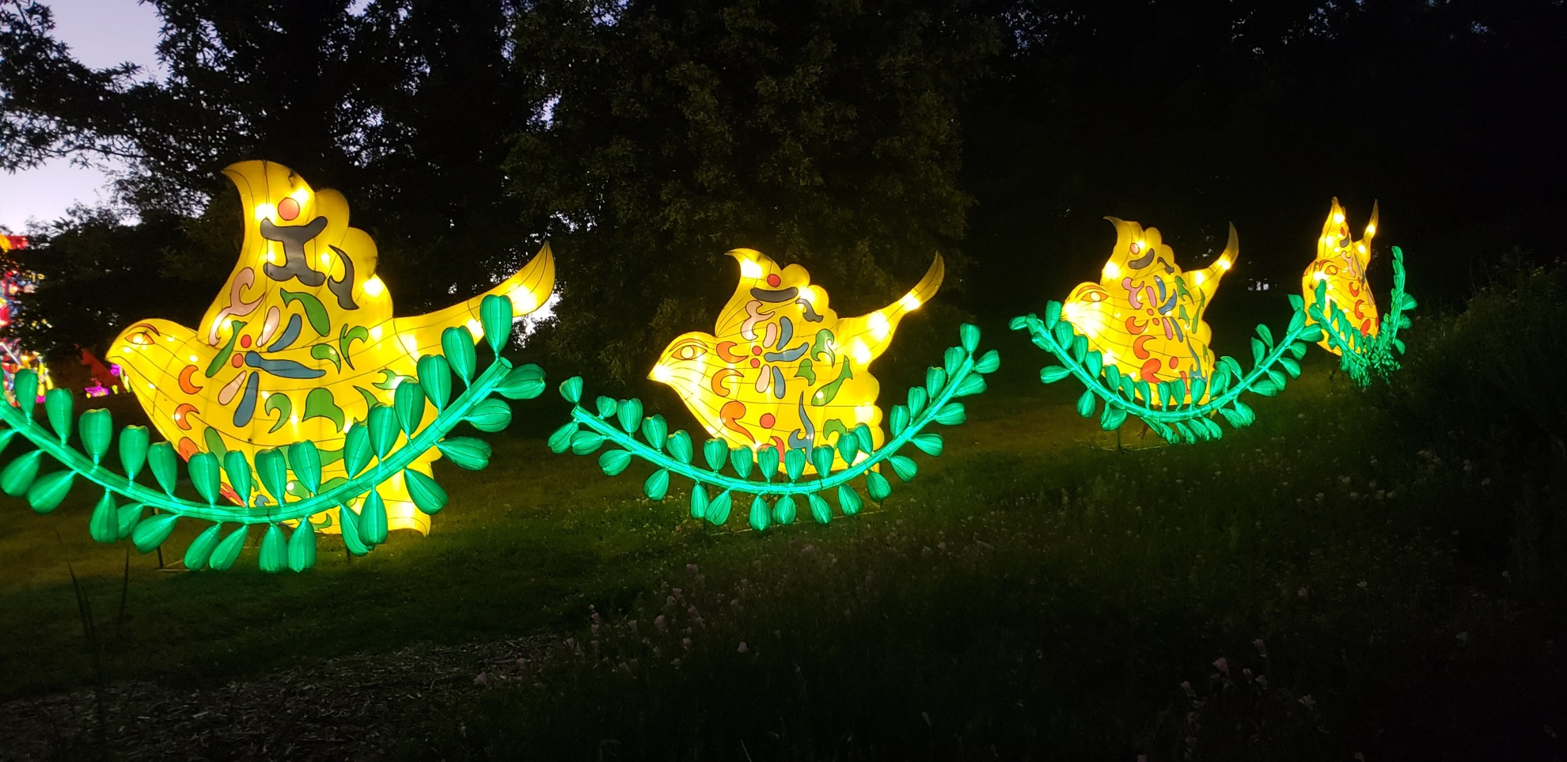
Dragon Lights Reno 2018

Slide 8
Dragon Lights Reno 2018
Monies Earned
  Agreement called for the 10% earnings to be put into the Arboretum donation account
  Earned $89,257.29
Ticket Sales | $80,940.37
Food | $7,866.92
Sponsorships | $450.00

Slide 9
Dragon Lights Reno 2018
Dragon Lights Budget 2018-19
Seasonal staff | $ 21,000.00
Utility Cart | $ 9,556.00
New Equipment | $ 6,600.00
Native Garden irrigation upgrade | $ 10,000.00
Honey's Garden upper east irrigation upgrade | $ 6,500.00
Slope irrigation upgrade | $ 15,000.00
Nevada Bell irrigation upgrade | $ 12,000.00
Putnam Drive Entrance irrigation upgrade | $ 6,000.00
 | $ 86,656.00

Slide 10
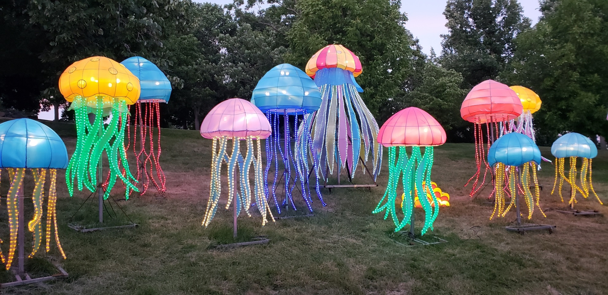
Dragon Lights Reno 2018

Slide 11
Dragon Lights Reno 2018
Overhead costs
  Rancho San Rafael Park staff time equated to $40,963.75
  Loss of revenue for Ranch House and Garden Rentals $15,050
  Supplies needed $860
  TOTAL In-kind contribution was $56,873.75

Slide 12
Dragon Lights Reno 2018
Assessment for future events
  Well received event by the public
  Put the Arboretum on the map
  Balancing the needs of the park and overall use of the park during an extended event
  Reduce overhead costs and perhaps negotiate a different split for future events

Slide 13
Dragon Lights Reno 2018
Thank you to the staff at Rancho San Rafael Park which includes the Arboretum, Museum, Park Rangers, and Park Maintenance staff for all of their assistance to make the event a success.
Thank you to a variety of County staff that assisted in the County/MAS night.
Thank you to the May Arboretum Society for their assistance and support.

Slide 14
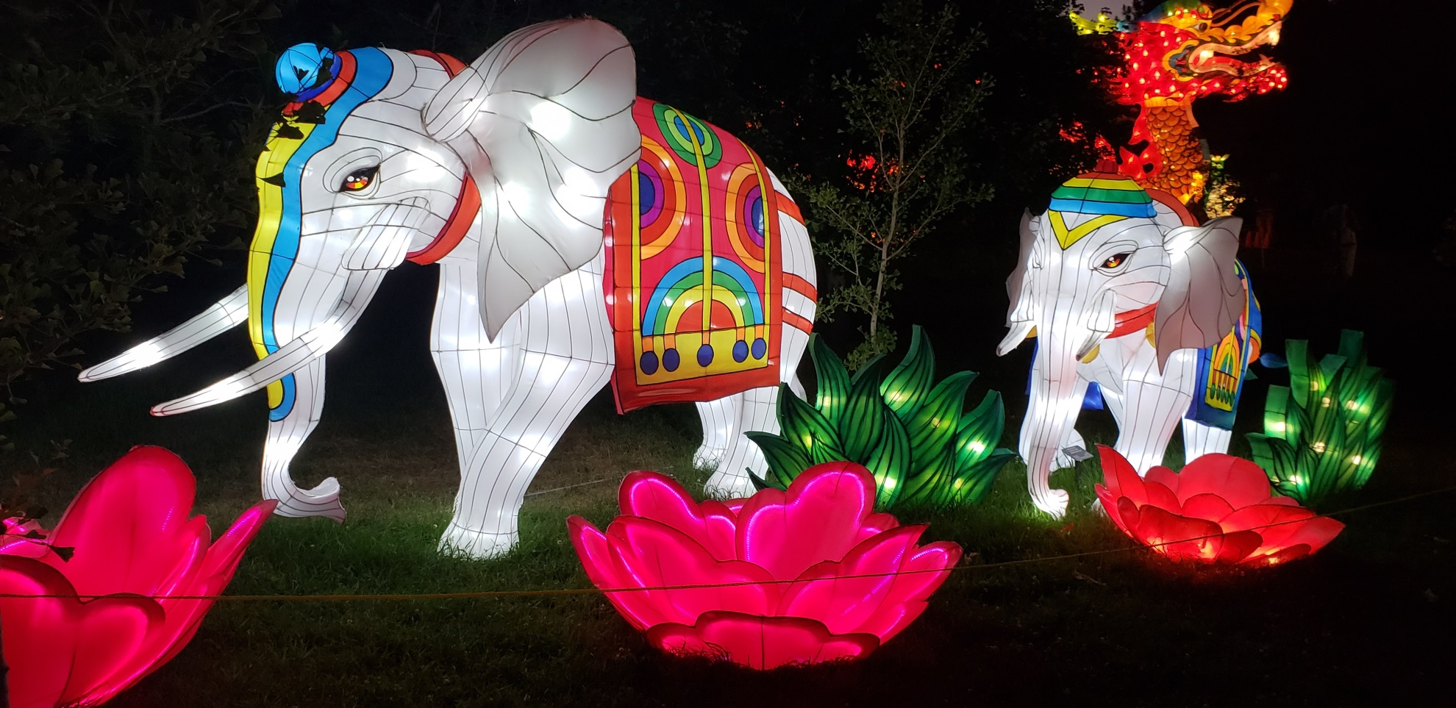
Dragon Lights Reno 2018

